Slide 1
Uber dataset

Slide 2
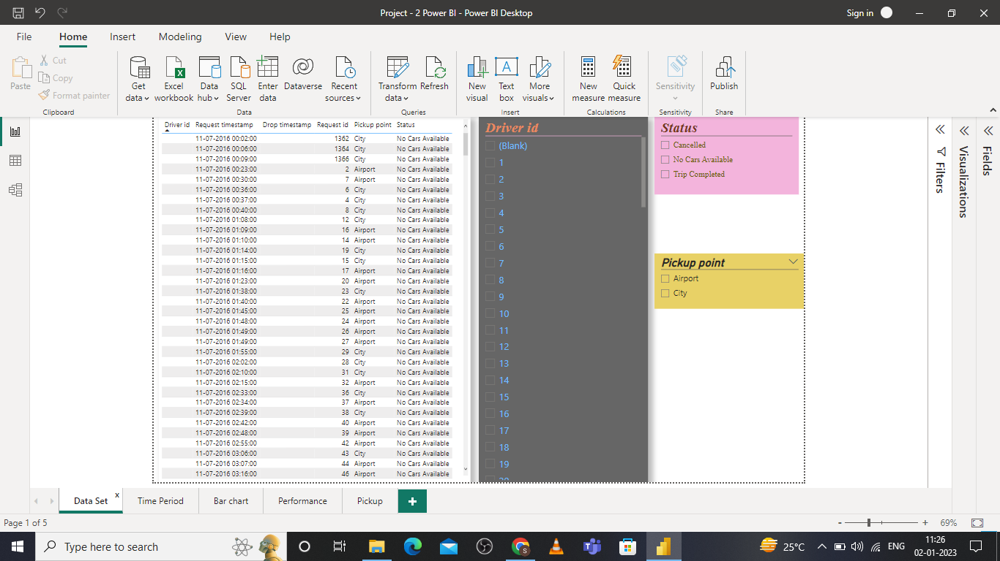
Dataset

Slide 3
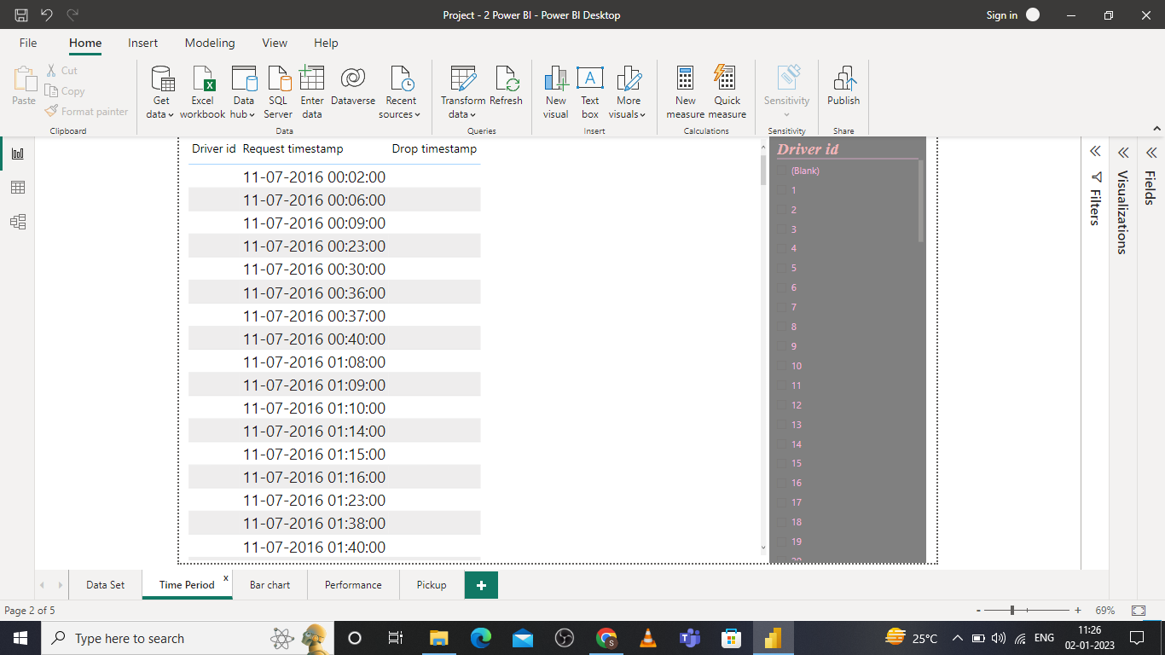
Time period

Slide 4
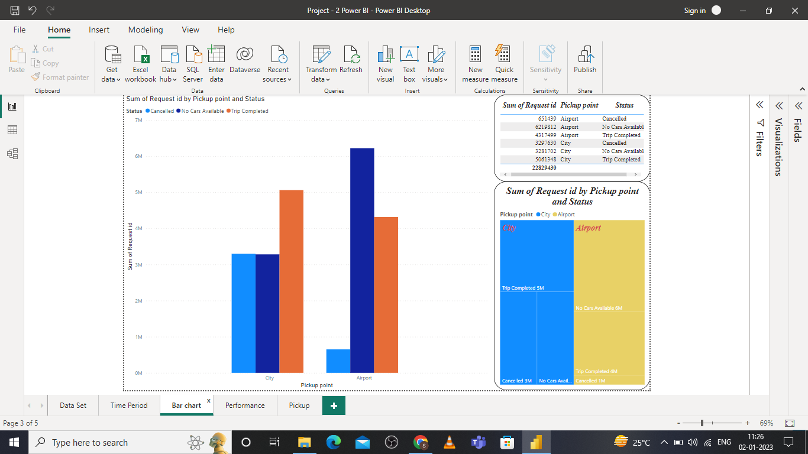
Bar chary comparison

Slide 5
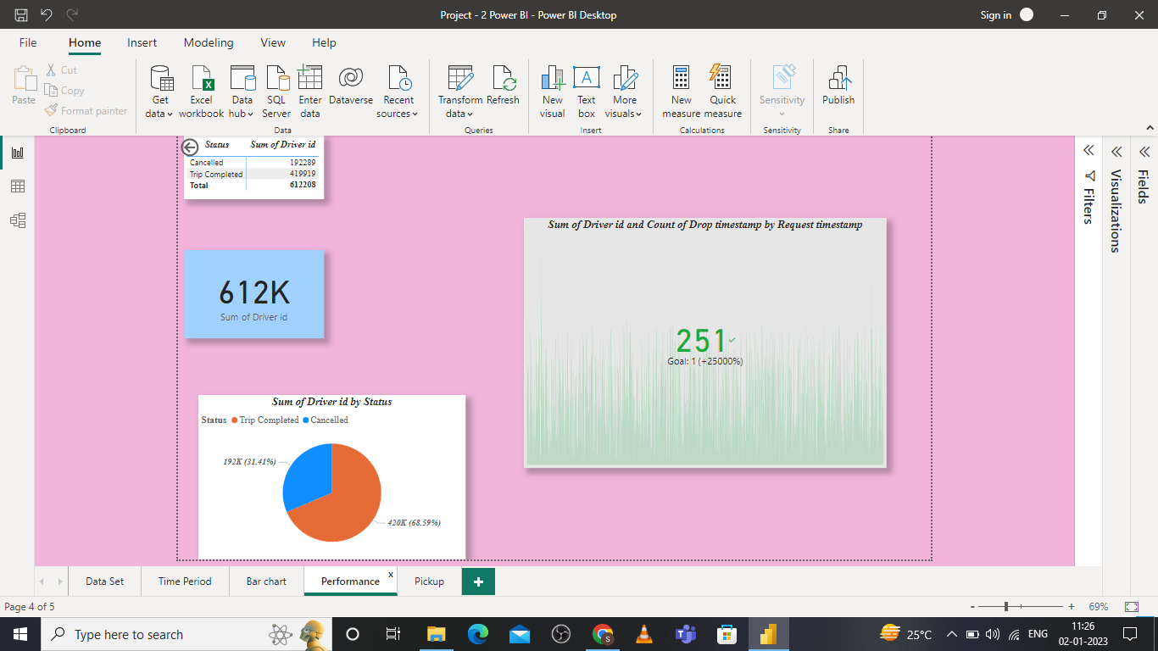
Performance

Slide 6
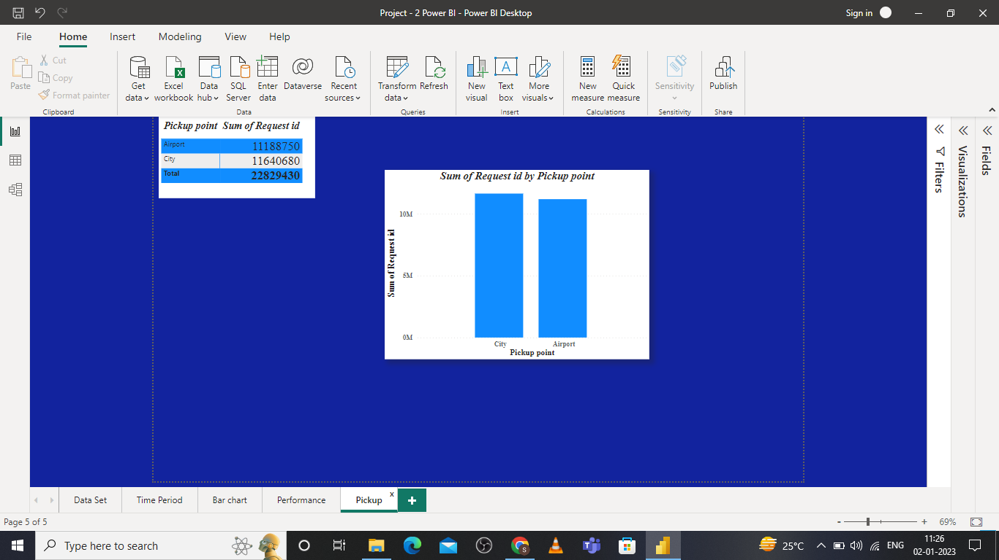
Pickup

Slide 7
Thank You

